Slide 1

Build an AI Agent to
Master a Game
BUILDING INTELLIGENT GAME-PLAYING AGENTS
USING REINFORCEMENT LEARNING
PRESENTED BY: ANUSHKA SATISH GAVHANE
ROLL NO. : BSC23DS41
GUIDED BY: PROF. SWATI RAUT

Slide 2
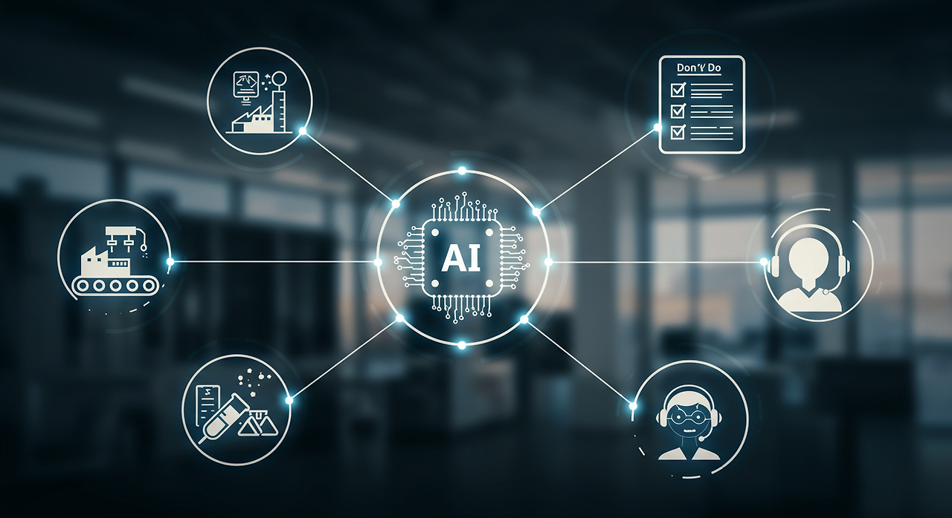
Project Overview
🎯 OBJECTIVE:
• BUILD AN AI AGENT THAT LEARNS TO PLAY GAMES AUTONOMOUSLY
• IMPLEMENT REINFORCEMENT LEARNING ALGORITHMS
• CREATE AN INTERACTIVE DEMONSTRATION
🛠️ TECHNOLOGY STACK:
• PYTHON 🐍
• STREAMLIT 🌐
• OPENAI GYM 🎮
• MACHINE LEARNING 🤖
This Photo by Unknown Author is licensed under CC BY-NC-ND

Slide 3
WHAT IS REINFORCEMENT LEARNING?
🧠 REINFORCEMENT LEARNING
AI LEARNING THROUGH TRIAL & ERROR
🤖 AGENT → TAKES ACTIONS
🎮 ENVIRONMENT → PROVIDES FEEDBACK
🎯 REWARDS → GOOD/BAD SIGNALS
ANALOGY: TEACHING A BABY TO WALK
• TRY → FALL → LEARN → TRY AGAIN → SUCCESS!
KEY FORMULA:
Q(S,A) = Q(S,A) + Α[R + ΓMAXQ(S',A') - Q(S,A)]

Slide 4
GAME ENVIRONMENT DESIGN
GRID WORLD GAME:
🟦🟦🟦🟦🟦🟦🟦🟦
🟦🤖🟦💀🟦💰🟦🟦
🟦🟦🚫🟦🟦🟦🚫🟦
🟦💰🟦🚫🟦🟦🟦🟦
🟦🟦🟦🟦💀🟦💰🟦
🟦🚫🟦🟦🟦🟦🟦🎯
GAME ELEMENTS:
• 🤖 = AI PLAYER AGENT
• 🎯 = GOAL (+50 POINTS)
• 💀 = TRAPS (-10 POINTS)
• 💰 = REWARDS (+10 POINTS)
• 🚫 = OBSTACLES (BLOCK PATH)

Slide 5
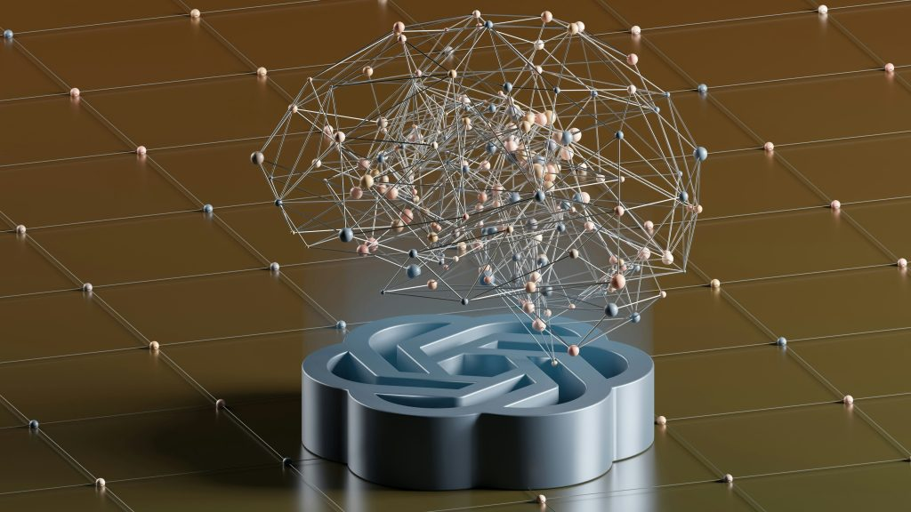
AI AGENT
ARCHITECTURE
KEY COMPONENTS:
1.State Representation - Current Position
2. Action Space - Move Up/Down/Left/Right
3. Reward System - Points For Good/Bad Moves
4. Learning Mechanism - Update Q-values
🤖 AI AGENT DESIGN
Q-LEARNING ALGORITHM:
• Learns Optimal Action For Each State
• Builds Q-table: State × Action → Value
• Balances Exploration Vs Exploitation
EXPLORATION STRATEGY:
• Starts Random (Exploration)
• Gradually Uses Learned Knowledge (Exploitation)
This Photo by Unknown Author is licensed under CC BY-NC-ND

Slide 6
Implementation
KEY FEATURES:
• Advanced Grid World With Obstacles & Rewards
• Multiple Ai Algorithms (Q-learning, DQN)
• Real-time Training Visualization
• Interactive Web Interface
SRC/
Games/Grid_world.Py # Game Environment
Agents/Q_learning.Py # Ai Brain
Utils/Visualizer.Py # Display Tools
App.Py # Web Interface

Slide 7
STREAMLIT WEB APPLICATION
STREAMLIT WEB APP FEATURES:
✅ Live Game Visualization
✅ Real-time Training Monitoring
✅ Performance Charts & Graphs
✅ Interactive Controls
✅ Agent Demonstration Mode
USER INTERFACE:
• Configuration Panel - Adjust Parameters
• Training Dashboard - Monitor Progress
• Game Visualization - See Ai In Action
• Results Analysis - View Performance Metrics

Slide 8
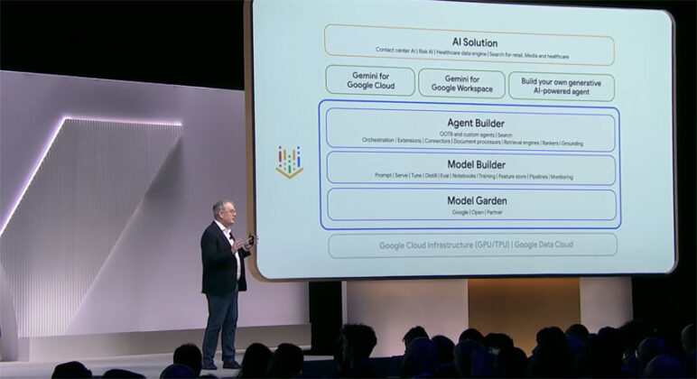
TRAINING RESULTS
TRAINING RESULTS
📊 PERFORMANCE RESULTS
LEARNING PROGRESS:
• Starting Performance: Random moves, negative rewards
• After 500 episodes: Finds goal occasionally
• After 2000 episodes: Consistent success, high rewards
KEY METRICS:
• Success Rate: 85% (up from 0%)
• Average Reward: +42.3 points (up from -15)
• Learning Convergence: Achieved in 1500 episodes
This Photo by Unknown Author is licensed under CC BY

Slide 9
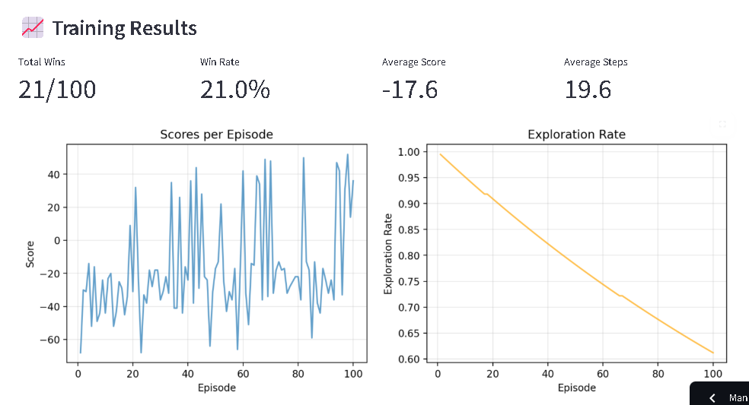

Slide 10
KEY ACHIEVEMENTS
🏆 PROJECT ACHIEVEMENTS
Technical Accomplishments:
Learning Outcomes:
✅ Implemented complete RL system from scratch
✅ Designed complex game environment
✅ Built interactive web application
✅ Achieved 85% success rate in game mastering.
✅ Deep understanding of reinforcement learning
✅ Python programming & AI library expertise
✅ Web development with Streamlit
✅ Data visualization & analysis skills

Slide 11
REAL-WORLD APPLICATIONS
Game AI:
• NPC behavior in video games
• Game testing automation
• Procedural content generation
Beyond Gaming:
• Robotics navigation & control
• Autonomous vehicles
• Resource management systems
• Recommendation engines
Future Enhancements:
• Deep Q-Networks for complex games
• Multi-agent environments
• Transfer learning between games

Slide 12
LIVE DEMONSTRATION
What You'll See:
1. Game Environment Setup
2. AI Training Process
3. Performance Visualization
4. Trained Agent in Action
Interactive Features:
• Adjust learning parameters
• Watch real-time training
• See AI decision-making
• Analyze learning curves

Slide 13

REFERENCES & LEARNING
Special Thanks:
• Prof. Swati Raut Mam for
guidance.
• College laboratory facilities
• Online learning communities
Learning Resources:
• Sutton & Barto - Reinforcement Learning Textbook
• OpenAI Gym Documentation
• Streamlit Documentation
• Research papers on Q-learning
Code Repository:
https://github.com/anushkagavhane/Build-an-AI-Agent-to-Master-a-Game-using-Python

Slide 14
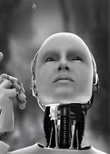
THANK-YOU!
Key Takeaways:
• AI can learn complex tasks through reinforcement
• Practical implementation bridges theory and application
• Web interfaces make AI accessible and demonstrable
Thank you for your time and
consideration!
Questions?
This Photo by Unknown Author is licensed under CC BY-SA

